Slide 1
INTRODUCTION TO ANATOMY, TERMINOLOGIES AND LEARNING
Ngozi Onuegbu PhD
Module Lead

Slide 2

Objectives of the Session
Understand the basic principles of anatomy.
Learn common anatomical terminologies.
Be introduced to strategies for effective learning in anatomy.
Notes:
Provide advice, guidance and support for students with a disability, a Specific Learning Difficulty (SpLD) such as Dyslexia or Dyspraxia, students who are Deaf or hearing impaired, blind or partially sighted students, students with chronic long-term health conditions and students with mental health difficulties.
DDS is part of Student Services:
Counselling Team.
Student Money and Accommodation Team (SMAA).
International Support Team.
Disabilities and Dyslexia Service (DDS).

Slide 3
What is Anatomy?:
Definition:
  Anatomy is the branch of biology concerned with the study of the structure of organisms and their parts.
Etymology: Derived formthe Greek word ‘anatome’ meaning dissection
Subdivisions of Anatomy:
  Gross Anatomy: Study of structures visible to the naked eye.
    Limbs, Thorax, Pelvis and Perineum, Head and Neck, Neuroanatomy
  Microscopic Anatomy: Study of structures at a microscopic level (histology).
  Developmental Anatomy: Study of the growth and development of an organism (Embryology).

Slide 4
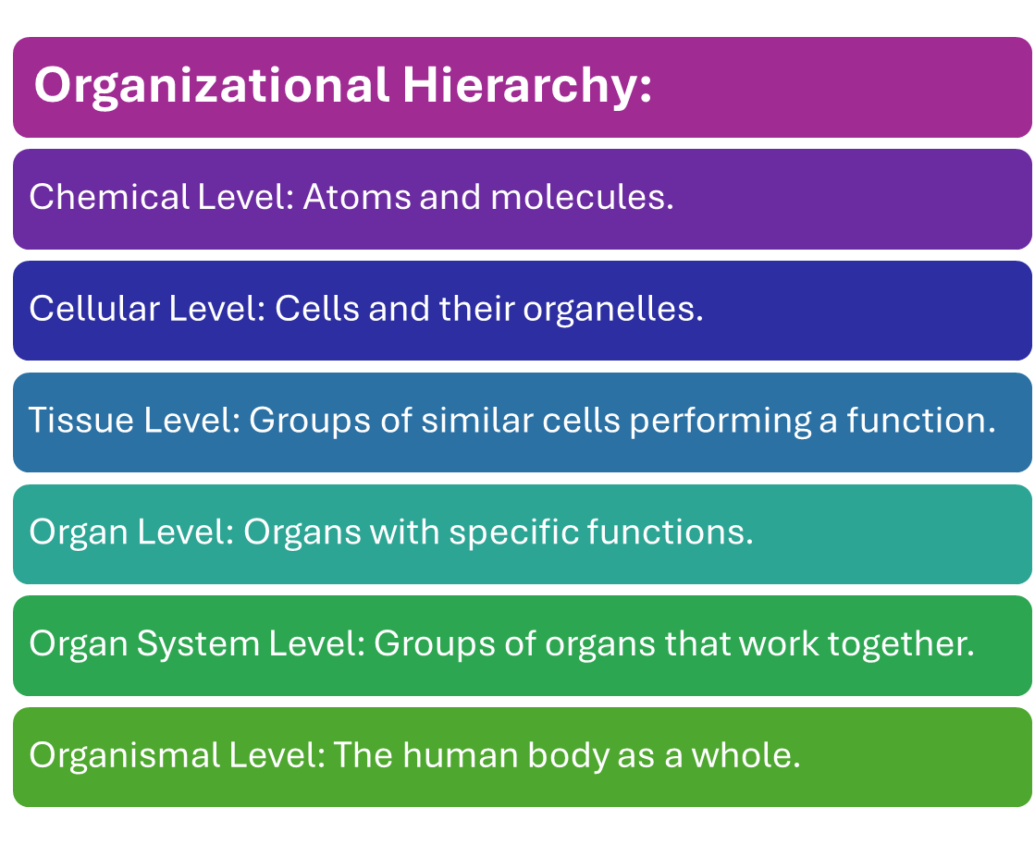
Levels of Structural Organization

Slide 5
Why Study Anatomy?
Understanding Human Structure:
Foundational knowledge for medical practice (physiotherapy).
Basis for understanding physiology and disease.
Helps in effective clinical reasoning, diagnosis and treatment planning.
Clinical Application: Essential in fields such as surgery, radiology, and physical therapy.
Case Example: Knowledge of the musculoskeletal system is crucial for treating fractures and dislocations.

Slide 6
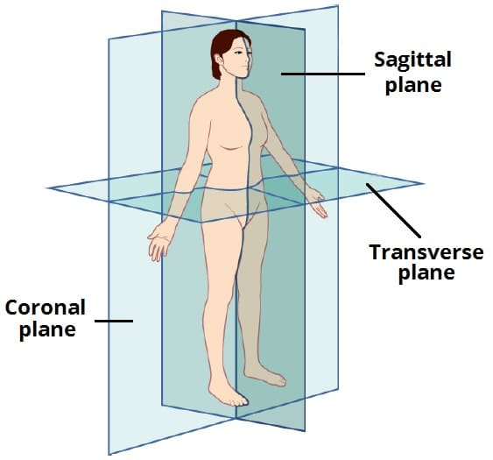
Let’s Start at the Very Beginning?
Anatomical Positions and Planes:
Anatomical Position:
  Standing upright, arms at sides, palms facing forward,
  feet slightly apart.
Body Planes:
  Sagittal Plane: Divides the body into right and left parts.
  Coronal (Frontal) Plane: Divides the body into anterior (front) and posterior (back) parts.
  Transverse Plane: Divides the body into superior (upper) and inferior (lower) parts.
  (Sagittal and Coronal run vertically to, and transverse runs parallel to the ground)

Slide 7
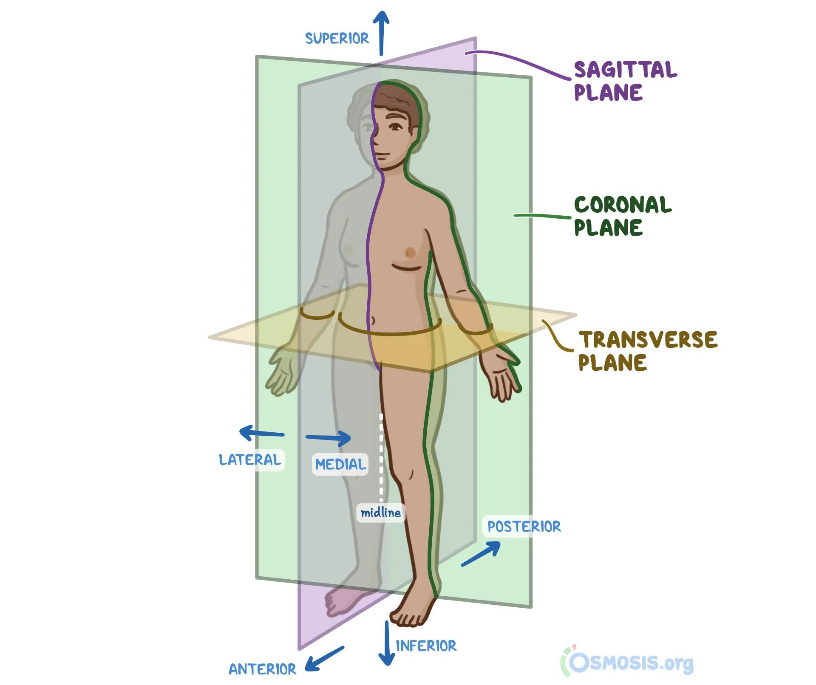
Cardinal Axes:
(Imaginary lines that help us think about the body in 3-D)
Useful for describing movements of the body
Horizontal (x-axis): points Medial-lateral e.g. Flexion/Extension of hinge joints (elbow and knee)
Longitudinal (y-axis): points Superior–inferior e.g. Movement of pivot joints AA joints, medial and lateral rotation
Sagittal (z-axis): Points Anterior-Posterior e.g. Abduction/ Adduction of ball and socket joints (hip/shoulder)
The arrows in this diagram represent the axes.
Notes:
Directional terms and body planes allow us to describe the relationship between anatomical structures, for example, the wrist is distal to the elbow, the ears are lateral to the eyes, the nose is located in the midsagittal plane. They are a part of a universal language for understanding anatomy. Helps us avoid confusion and enhance communication between health professionals.

Slide 8
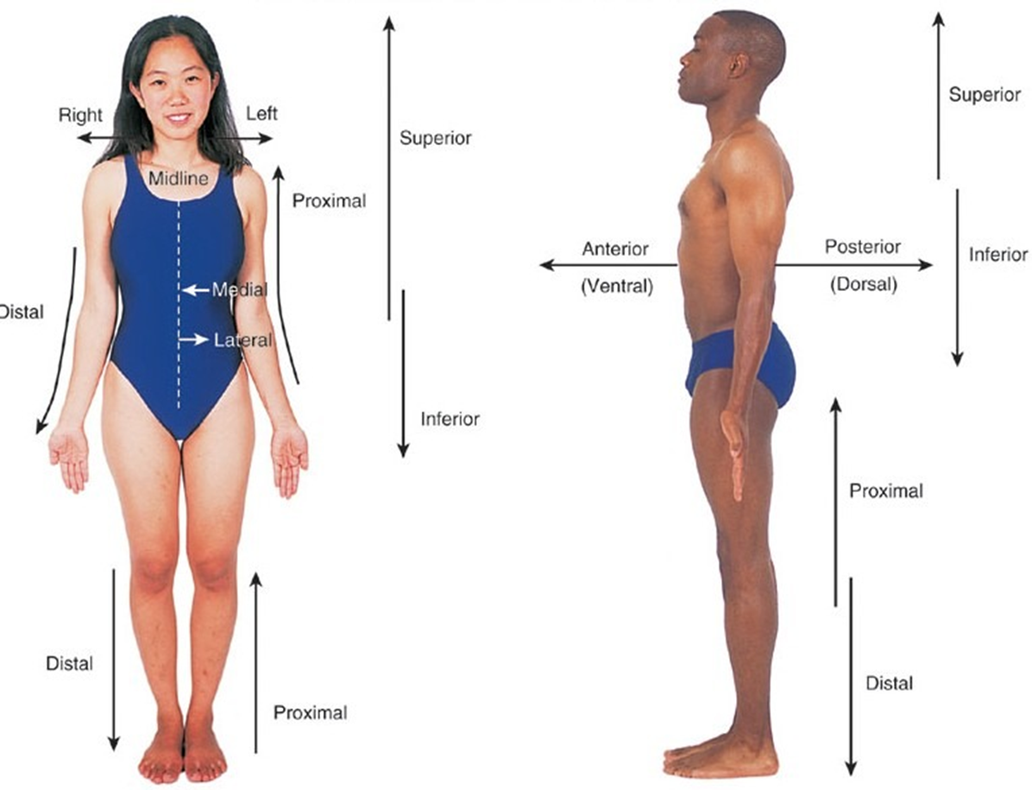
Anatomical Terminologies
Directional Terms:
Superior (Cranial): Toward the head.
Inferior (Caudal): Away from the head.
Anterior (Ventral): Front of the body.
Posterior (Dorsal): Back of the body.
Medial: Toward the midline.
Lateral: Away from the midline.
Proximal: Closer to the origin of the body part.
Distal: Farther from the origin of the body part.

Slide 9
A little Quizlet
Name the joints your upper limb and lower limb.
Explain the relationship of each joint to the other joints in the same limb:

Slide 10
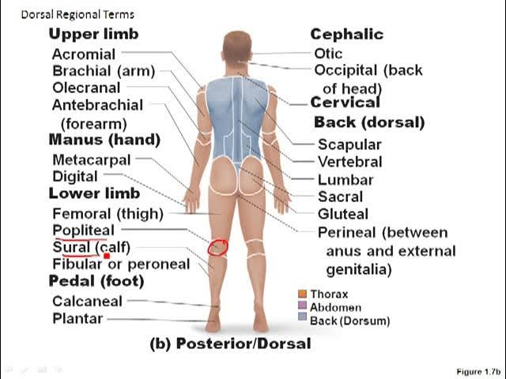
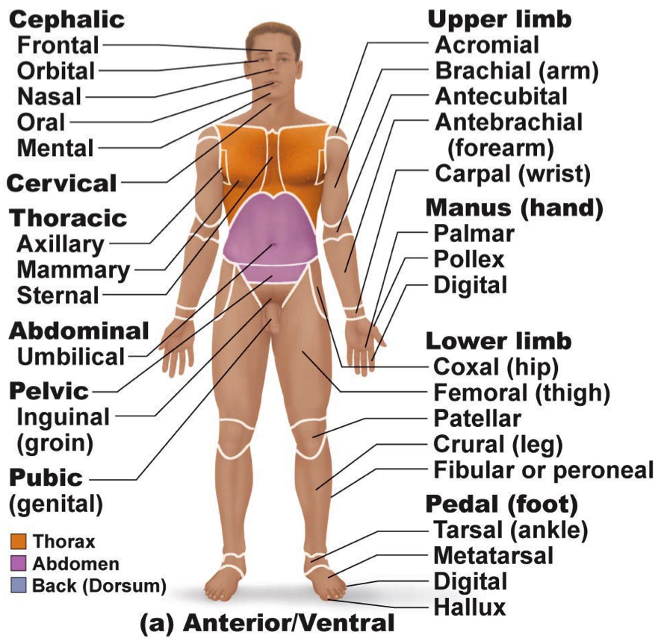
Regional Terminologies
organizes the body into several body parts or regions:
Body Regions:
Cephalic (Head)
Thoracic (Chest)
Abdominal (Belly)
Pelvic (Hip Area)
Upper Limb (Arm and Forearm)
Lower Limb (Thigh and Leg)
Notes:
In Anatomy, we use specific terms to clearly communicate the location of structures within the human body. These are directional terms, regional terms and body planes. To avoid confusion and miscommunication, we always use a standard reference point for these terms; this reference point is the anatomical position. The anatomical position is when the body is standing erect, with the face looking forwards, the feet parallel, the arms hanging at the sides, the palms facing forwards and the thumbs pointing away from the body.

Slide 11
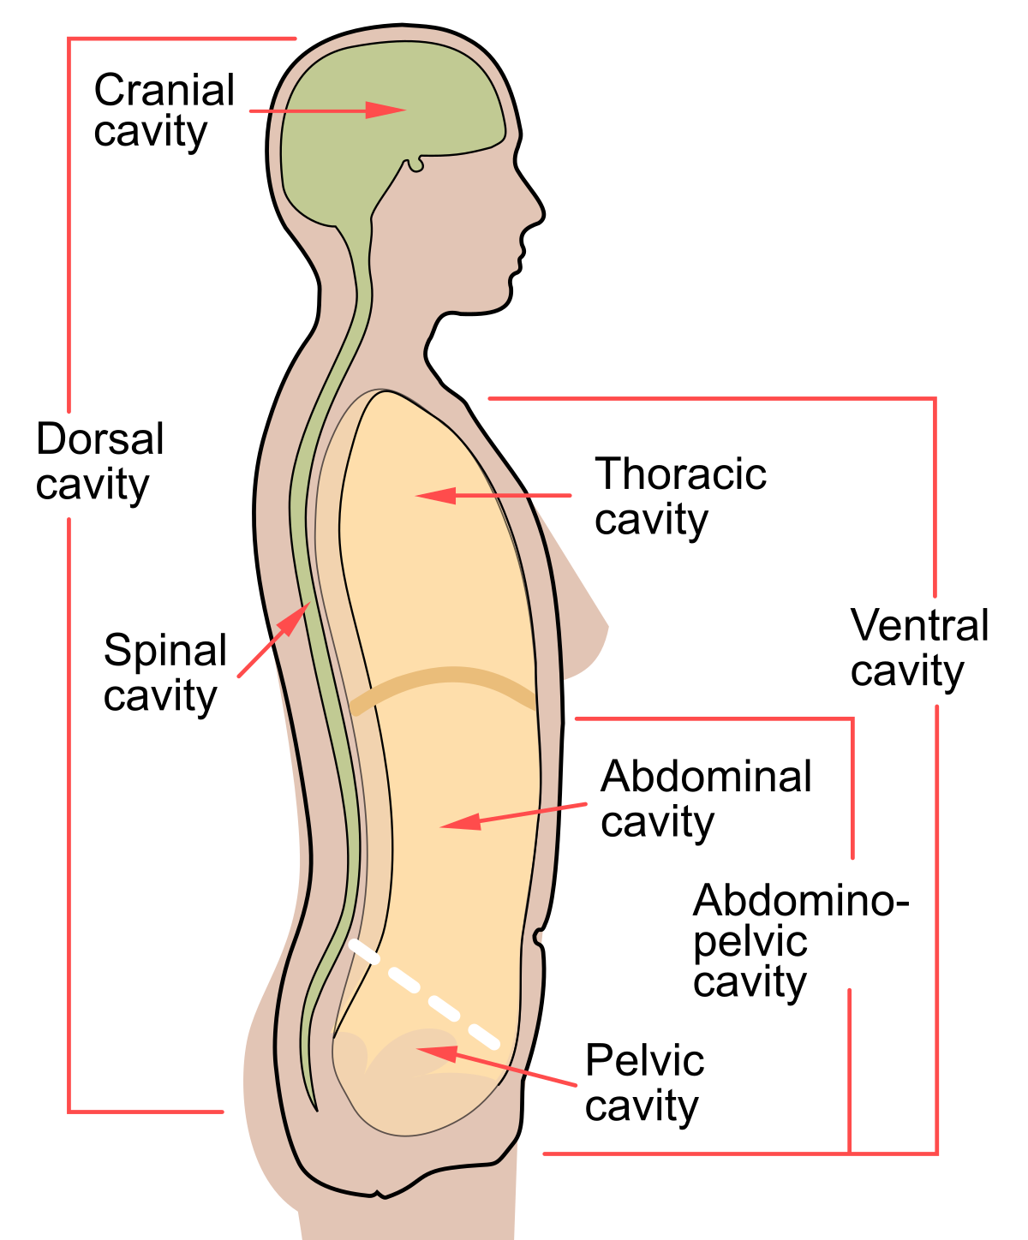
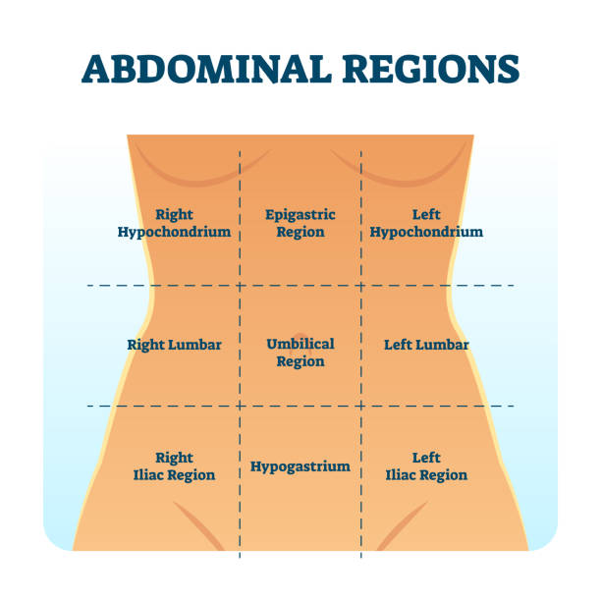
Body Cavities and Regions:
Dorsal Cavity: Includes cranial and spinal cavities.
Ventral Cavity: Includes thoracic and abdominopelvic cavities.
Importance of Body Cavities: Provides space for organs and allows flexibility in movement.
Abdominal Regions (used for clinical purposes):
Epigastric, Umbilical, Hypogastric
Right and Left Hypochondriac, Lumbar, and Iliac
Example: The liver is primarily located in the right hypochondriac
and epigastric regions. Useful for localising visceral and referred pain.

Slide 12
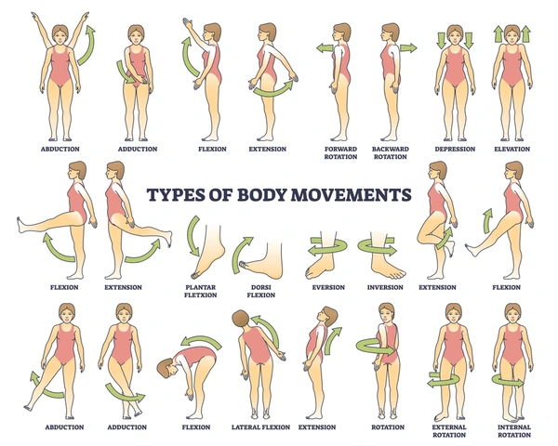
Movement Terminologies
Examples:
Flexion vs Extension: Bending vs straightening a joint.
Abduction vs Adduction: Movement away from vs toward the midline.
Supination vs Pronation: Rotation of the forearm to face palm up vs palm down.
Example: Flexion of the knee occurs when bending the leg, and supination of the forearm happens when turning the palm upward.

Slide 14
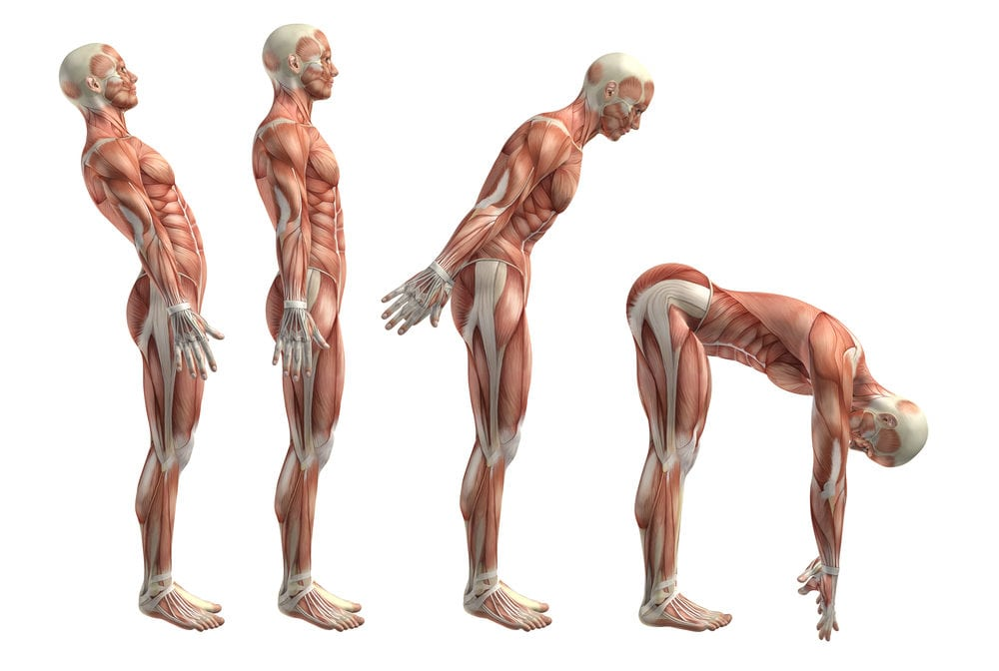
LET’S PLAY:
What movements are these?
What planes do they occur in?
What axis do they occur in?

Slide 15
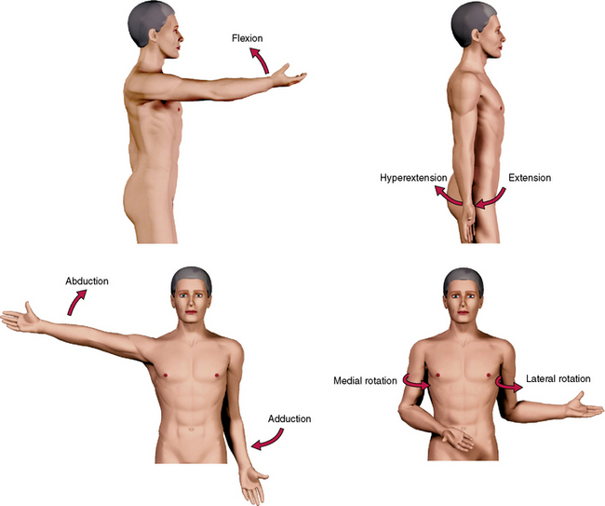

Slide 16
Common Anatomical Abbreviations
Examples:
CNS: Central Nervous System
PNS: Peripheral Nervous System
GI: Gastrointestinal
CVS: Cardiovascular System
MSK: Musculoskeletal

Slide 17
Anatomical Variability
Importance of Anatomical Variations:
No two individuals are exactly alike anatomically.
Understanding common variations improves clinical diagnosis.

Slide 18
Learning Strategies in Anatomy
Active Learning: Engage in dissections for hands on experience with cadavers, lab practicals, and 3D anatomy tools.
Visual Learning: Use diagrams, videos, and apps to understand body structures.
Mnemonics: Employ mnemonic devices to remember anatomical terms (e.g., "Some Lovers Try Positions That They Can’t Handle" for carpal bones).
Spaced Repetition: Regular review of terms and concepts over time.
Case-Based Learning: Apply anatomical knowledge in clinical scenarios.

Slide 19
Study Tips for Anatomy
Consistent, daily study sessions.
Use mnemonics for memorization.
Label diagrams repeatedly to reinforce knowledge.
Attend practical lab sessions and ask questions.

Slide 20
Common Challenges in Learning Anatomy
Volume of Information: Memorizing a large amount of data can be overwhelming.
Understanding Spatial Relationships: Requires 3D thinking and practice.
Clinical Application: Integrating anatomy with physiology and pathology.
To succeed, come up with your own unique strategies to overcome these challenges.

Slide 21
Overcoming Challenges in Learning Anatomy
Study Groups: Collaborate with peers to discuss and clarify difficult concepts.
Regular Practice: Continually engage with materials through quizzes, apps, and lab sessions.
Integration with Clinical Practice: Relate anatomical knowledge to case studies and real-world patient care.

Slide 22
Key Resources for Anatomy Learning
Textbooks: Gray’s Anatomy, Clinically Oriented Anatomy (Moore) See Reading List
3D Anatomy Apps: Visible Body, Complete Anatomy
Websites and Online Platforms: TeachMeAnatomy, Khan Academy, Kenhub, Videos and Podcasts

Slide 23
Conclusion
Anatomy is fundamental for understanding the human body and its functions.
Use anatomical terms to describe the body accurately.
Apply active learning techniques to master the subject.
Consistent study, using a variety of learning resources, is essential for success.

Slide 24
References
Drake, R. L., Vogl, A. W., & Mitchell, A. W. M. (2019). Gray's Anatomy for Students. 4th ed. Philadelphia: Elsevier.
Moore, K. L., Dalley, A. F., & Agur, A. M. R. (2018). Clinically Oriented Anatomy. 8th ed. Philadelphia:
Wolters Kluwer.Tortora, G. J., & Nielsen, M. T. (2017). Principles of Human Anatomy. 14th ed.
Hoboken, NJ: Wiley.Netter, F. H. (2018). Atlas of Human Anatomy. 7th ed. Philadelphia:
Elsevier.Hansen, J. T. (2019). Netter’s Clinical Anatomy. 4th ed. Philadelphia: Elsevier

